Slide 1
Data Glacier Virtual Internship: LISUM11
G2M Cab Investment Case Study
-Isha Panjwani
21st July 2022

Slide 2
Client and Problem Statement
XYZ is a private firm in The United States of America. The company is considering for expansion of their services and has decided to go ahead with the G2M strategy. The company has got business proposals from 2 companies.
Objective : To provide actionable insights to help XYZ firm in identifying the right company for making investment.
The Analysis has been done with the following procedures:
Understanding data and its structure
Estimating number of trips, identifying top users by demographics, and profit for both the companies.
Identifying the most popular and lucrative cab service
Investment recommendations

Slide 3

Pink cab and Yellow cab company
The investment proposal is from the two following companies:
Pink Cab Company in USA
Yellow Cab Company in USA
Both the companies have there services established in 19 different cities of the US.
Pink Cab Company
The Pink cab company has travelled approximately 1.9M KMs in total in the year 2016-2018.
Yellow Cab Company
The Yellow cab company has travelled approximately 6.2M KMs in total in the year 2016-2018.

Slide 4
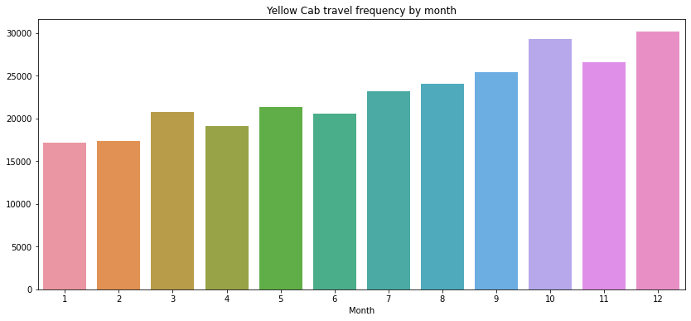
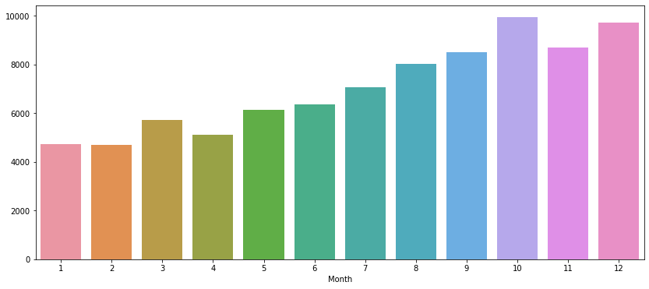
Number of Transactions per month
Pink Cab Travel frequency by month
The above graph shows that the travel frequency of customers is higher in winter months as compared to other. Also, the highest number of transactions go nearby 10000.
The above graph shows that the travel frequency of customers is higher in winter months as compared to other. Also, the highest number of transactions go nearby 30000.

Slide 5
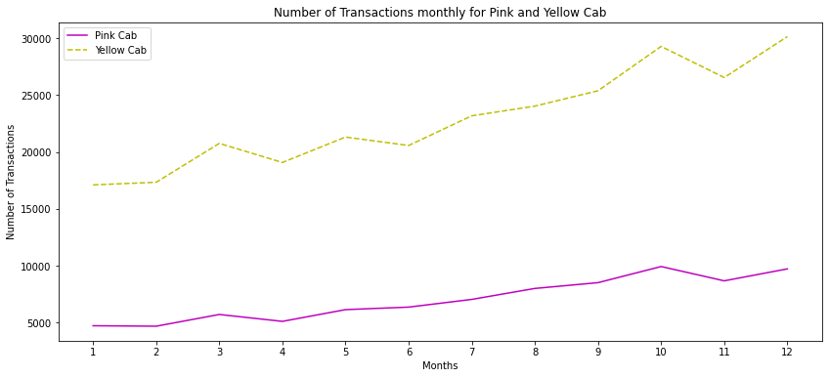
Comparing Pink and Yellow cab company
The graph depicts that yellow cab is performing 3x better than the pink cab.

Slide 6
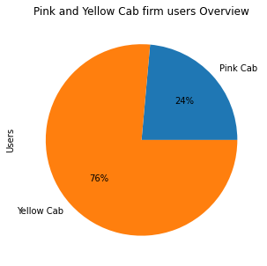
Pink and Yellow Cab Users Overview
Approximately 3/4th portion of the cab market is acquired by Yellow Cab Company

Slide 7
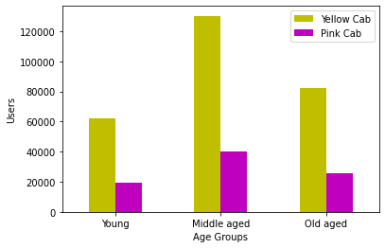
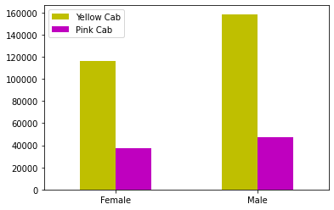
User’s preference by demographics
Middle aged people are more likely to book a cab in both the companies. But yellow cab is having higher number of users than pink cab.
Number of male users are approximately 15% more than female in both the companies

Slide 8
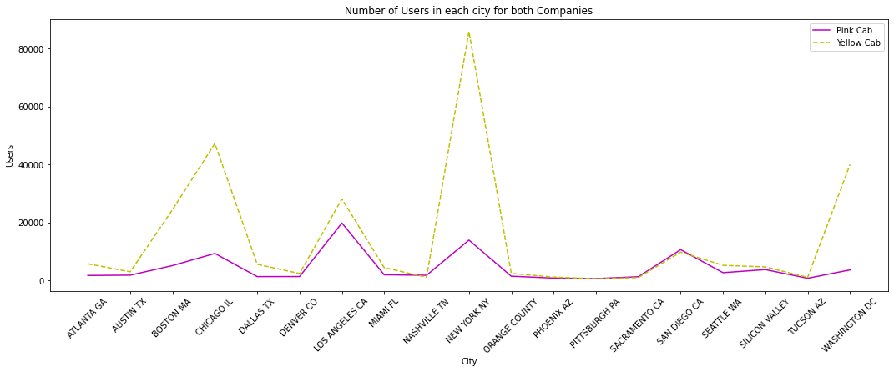
Users summary by city
This graph summarizes that yellow cab company has a greater number of users in most of the cities. Metropolitan cities such as Boston, Chicago, New York, LA , and Washington see a greater hike than other cities.

Slide 9
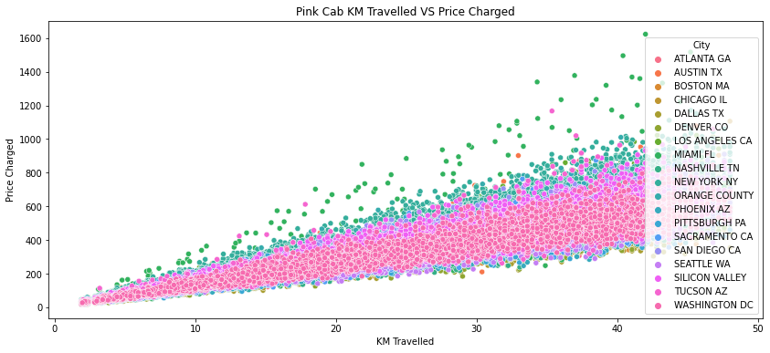
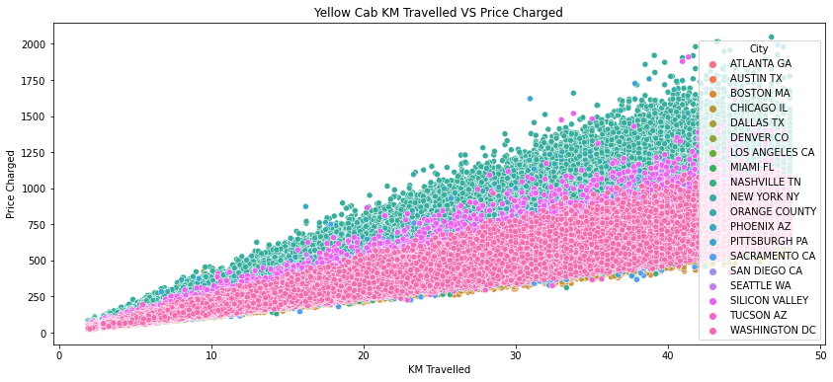
Comparing KM Travelled with price charged for both companies in each city. For same distance travelled, prices are higher in metropolitan cities as compared to suburb areas. Yellow cab charges more in suburban areas too than Pink cab.

Slide 10
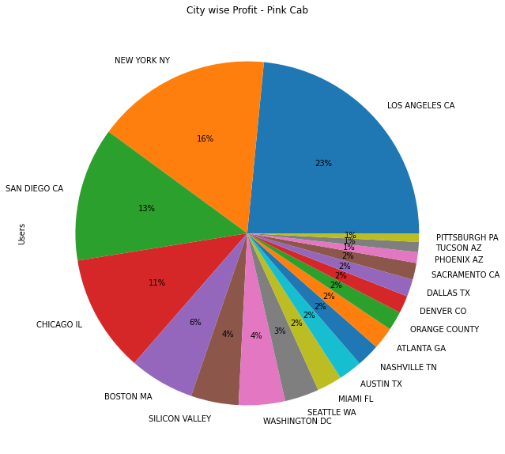
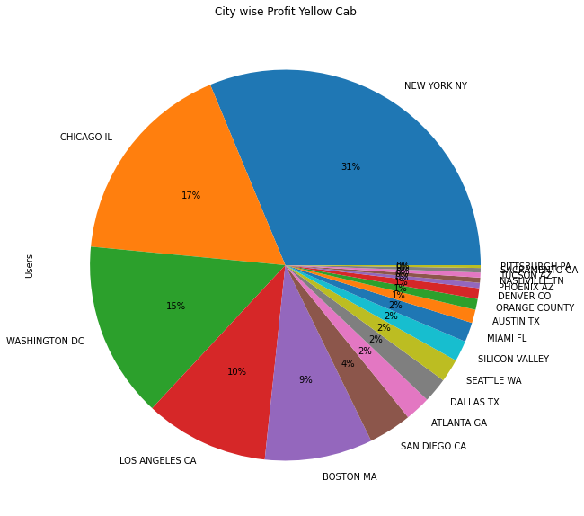
Profit share by city
More than 50% of the Users for Pink Cab are from LA, New York, and San Diego
Nearby 3/4th of the market users are from New York, Chicago, Washington and LA.

Slide 11
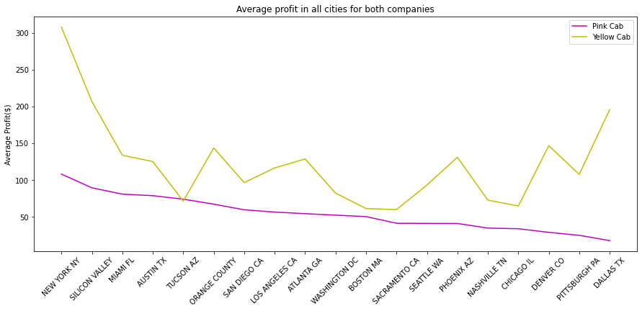
Comparing Average Profit for both companies by City
Average profit for pink cab is the highest in New York of a little more than $100. And the least in Dallas, TX for nearby $10. Average profit for both companies is similar in cities like Tucson & Boston. Whereas average profit for Yellow cab is highest in NYC of approximately $ 300. Yellow cab is also performing better in cities like Denver and Dallas in which Pink cab could not perform well.

Slide 12
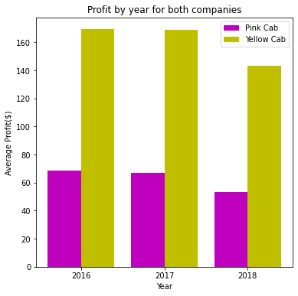
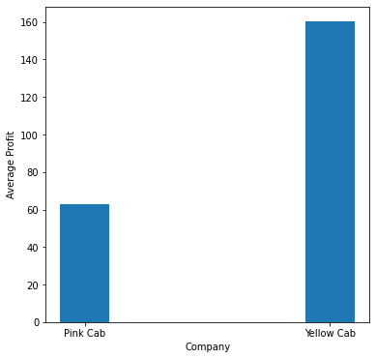
Average Profit
Average profit for both the companies is declining from the year 2016 to 2018. Average profit of the Yellow company is nearby 2.5 times higher in all the years than Pink cab.
Average profit for yellow cab company is 2.6 times higher than average profit for pink cab company.

Slide 13
Recommendations
We have evaluated both the cab companies on following factors and have concluded that Yellow Cab Company is better for investment than Pink Cab Company.
Number of transactions: Both the companies have higher number of transactions in the months of October, November, and December. But as observed Yellow Cab has 3x more customers throughout the year.
Market Share: Almost 75% of the cab users prefer Yellow Cab Company over Pink Cab Company.
Age wise Reach: Yellow cab has higher customers in all age groups and the most popular among middle aged group.
Gender wise Reach: Yellow cab has significantly higher number of both male and female users. Although male cab service users are 15% higher than female cab service users.
Average Price charged by KM: Yellow cab average charge per KM is almost 3 times the average charge of Pink cab.
Average Profit: Yellow Cab company has approximately 2.5 times higher average profit than Pink Cab company.
Based on the data analysed, Yellow Cab company is recommended to XYZ company for investment.

